Slide 1
Precision Agriculture
Week 3

Slide 2
Mission Statement
Explore convolution implementations on FPGA.
Convolution is inarguably the most complex operation utilized in Convolutional Neural Networks (convnets). Owing to the billions of independent multiply-accumulations (MACs) involved.
Although GPUs have shown significant performance improvements in both training and inference stages, they are not well-suited for mobile vision applications where both energy and real-time constraints need to be satisfied.
In contrast, FPGAs have demonstrated massive parallelization capabilities, with fast DSPs and on-chip memory, at a lower energy cost than GPUs.

Slide 3
Refresh
A convnet consists of an input layer, several hidden layers, and an output layer. During training, a convnet recursively updates its layer weights using back propagation to compute the weights and stochastic gradient descent to minimize the loss function using the computed weights.
A forward pass or inference stage of a convnet involves passing the input through a series of conv layers for feature extraction followed by a few fully-connected layers for classification.
A conv layer computes multi-adds between the input to the layer and the learned model or kernels in a sliding window fashion to compute output activations of the layer.
There are several other trivial operations used in convnets such as pooling, normalization and activation functions.

Slide 4
Aim
Extensive research effort has focused on optimization strategies such as approximation, quantization, pruning, and filter sparsification to reduce the arithmetic and memory complexity.
While these approaches help in improving performance and memory footprint of convnets, we consider them tangent to our discussion and instead focus on algorithmic optimization strategies for the convolution operation through reviewing:
Depthwise separable convolutions (MobileNet and ShuffleNet)

Slide 5
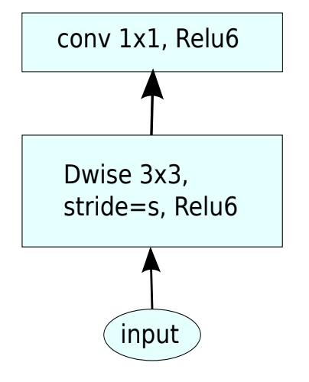
MobileNet V1
The MobileNet model (Google) is based on Depthwise Separable convolutions which is a factored form of the standard convolution.
Depthwise separable conv are split into a depthwise convolution and a 1×1 convolution called a pointwise convolution. Standard architecture shown in Fig X.
The standard convolution operation has the effect of filtering features based on the convolutional kernels then combining them in order to produce a new representations.
The filtering and combination steps can be split into two steps via the use of depthwise separable convolutions.
MobileNet introduces a set of two hyper-parameters in order to build very small, low latency models that can be easily matched to the design requirements for mobile and embedded vision applications.

Slide 6
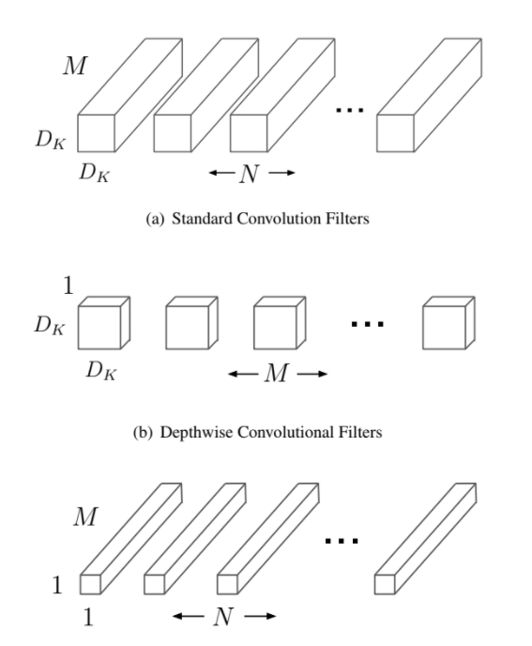
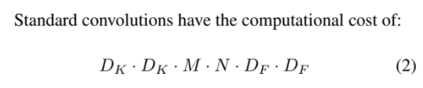

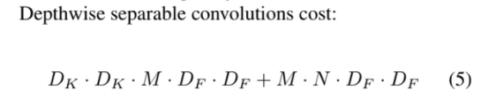
Why Depthwise Separable convolutions
Notes:
DK: (filter dimensions), M: (input depth), N: (output depth), DF: (input dimensions)

Slide 7
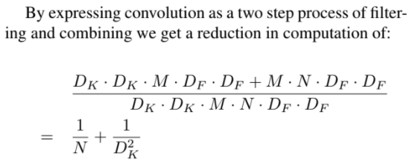
Why Cont.
Notes:
DK: (filter dimensions), M: (input depth), N: (output depth), DF: (input dimensions)

Slide 8
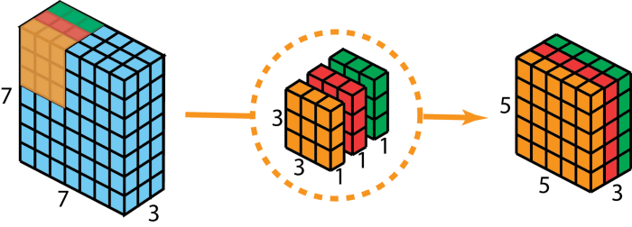
Depthwise Conv (3x3 DW Conv)
In Depthwise conv, each filter channel is applied separately to its corresponding feature map channel without accumulating over depth.
For MobileNets the depthwise convolution applies a single filter to each input channel. Then a trivial batch normalisation followed by a ReLU operation.
The pointwise convolution then applies a 1x1 convolution to combine the outputs of the depthwise convolution.

Slide 9
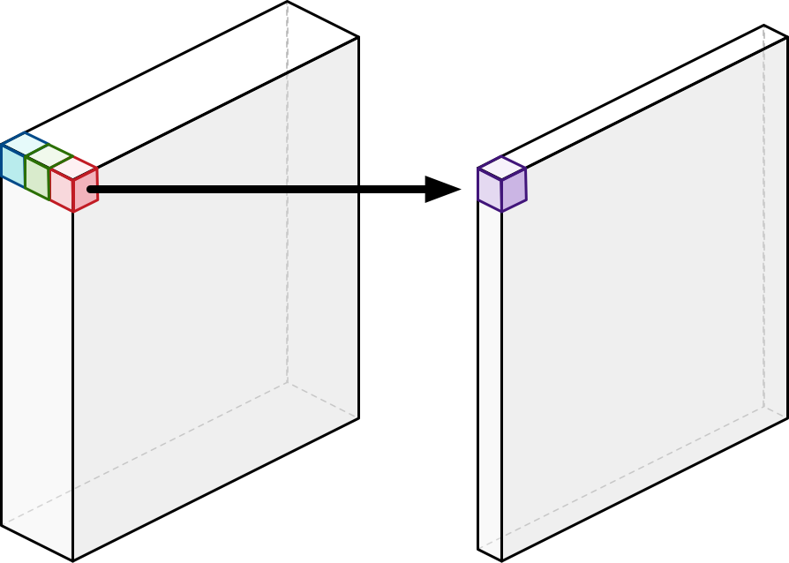
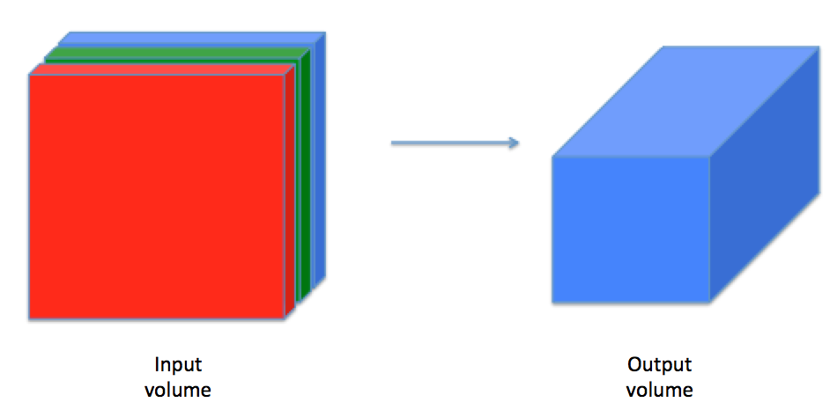
Pointwise Conv (1x1)

Slide 10
Pointwise Conv (1x1)
Pointwise conv is utilized to condense representations by reducing the depth of the feature maps.
Thus MobileNet is done with a convolutional layer that uses between 8 to 9 times less computation than standard convolutions at only a small reduction in accuracy.
In Depthwise conv, each filter channel is applied separately to its corresponding feature map channel without accumulating over depth.
For MobileNets the depthwise convolution applies a single filter to each input channel. Then a trivial batch normalisation followed by a ReLU operation.
The pointwise convolution then applies a 1x1 convolution to combine the outputs of the depthwise convolution.

Slide 11
Hyper Params.
Although the base MobileNet architecture is already small and low latency, many times a specific use case or application may require the model to be smaller and faster.
In order to construct these smaller and less computationally expensive models two very simple parameters are introduced to thin a network uniformly at each layer.
Where α is the width multiplier and ρ is resolution multiplier.
Notes:
DK: (filter dimensions), M: (input depth), N: (output depth), DF: (input dimensions)

Slide 12
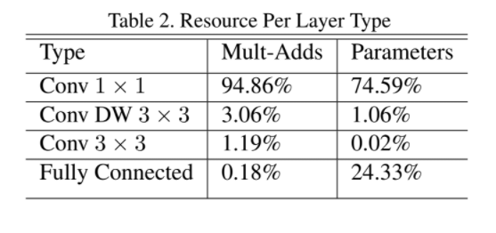
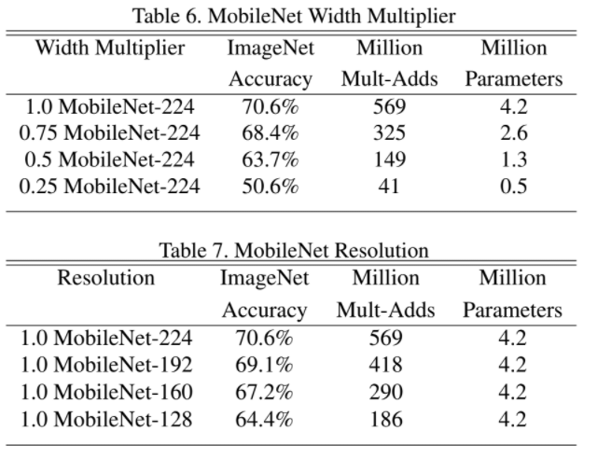
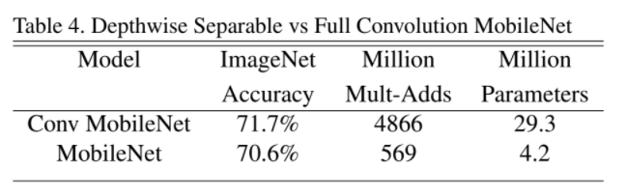
Results 2017 (Paper)

Slide 13
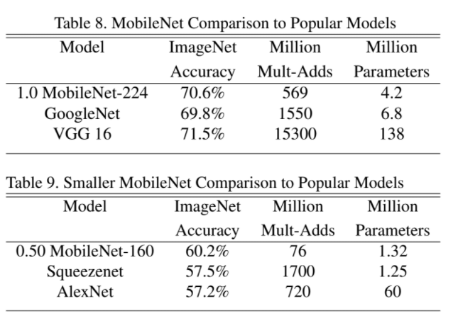
Results Cont.

Slide 14
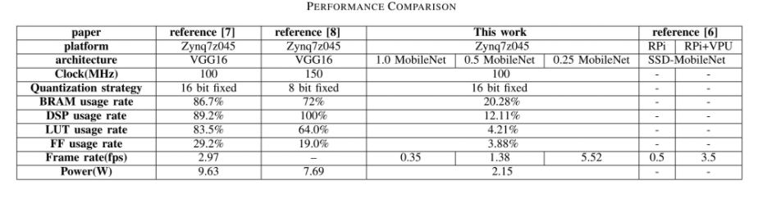
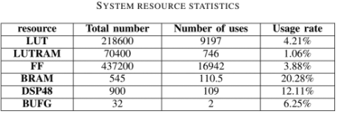
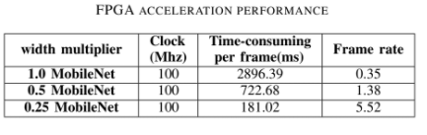
Results 2019 (FPGA)

Slide 15
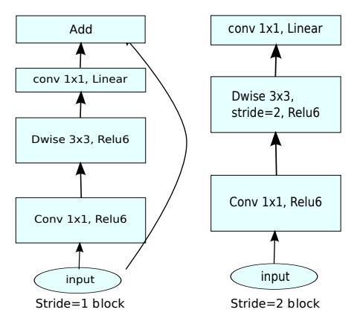
MobileNet V2
MobileNet V2 is introduced with inverted residual structure. With non-linearities in narrow layers removed.

Slide 16
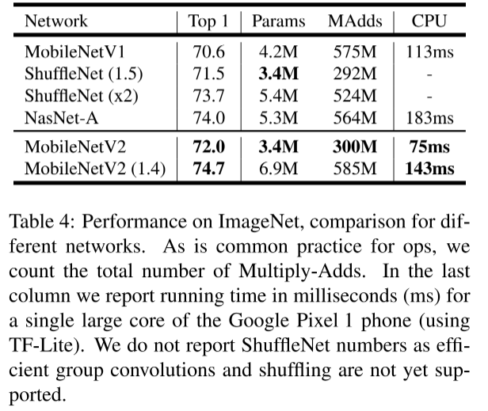
Results 2019 (Paper)

Slide 17
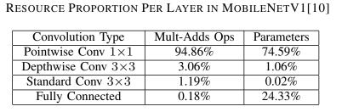
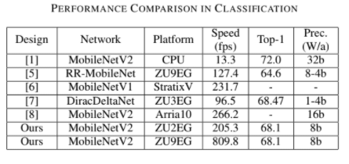
Results 2019 (FPGA)

Slide 18
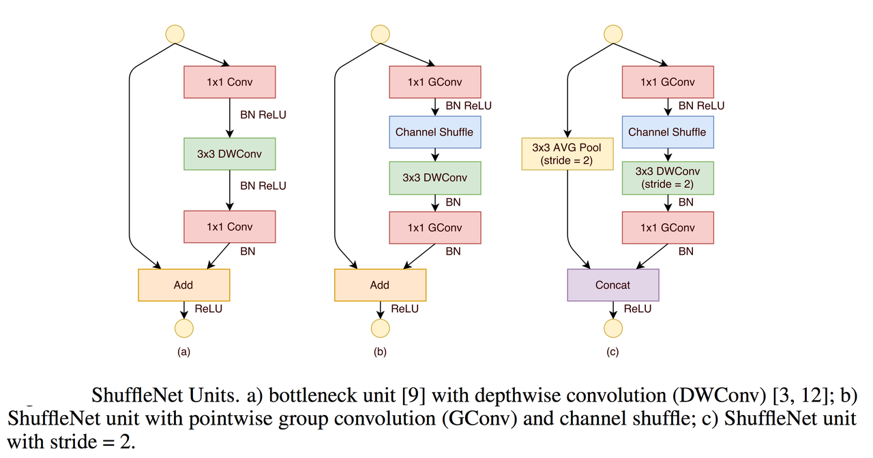
ShuffleNet V1
ShuffleNet consists of repeated building blocks that form each layer, called shufflenet units.
A shufflenet unit consists of a pointwise (1x1) group convolution (GConv) followed by a channel shuffle operation then a depthwise conv (3x3 DWConv).

Slide 19
Pointwise Conv (1x1)
Pointwise conv is utilized to condense representations by reducing the depth of the feature maps.
Although pointwise conv helps project representations in deep feature maps to shallower feature maps, a 1x1 receptive field does not encode information from neighboring pixels in each channel of the feature map.

Slide 20
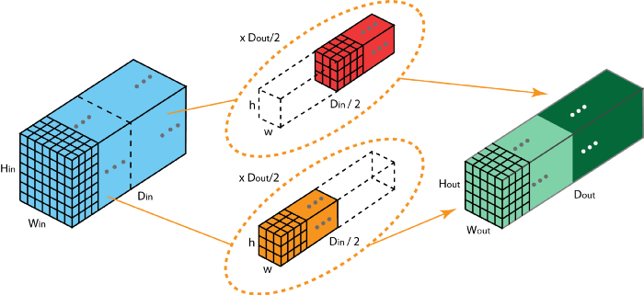
Grouped Conv (GConv)
Grouped convolution further reduces the complexity of the layer where each feature map group is convolved separately with a kernel map.
It was at first introduced by AlexNet to split a network into two GPUs.

Slide 21
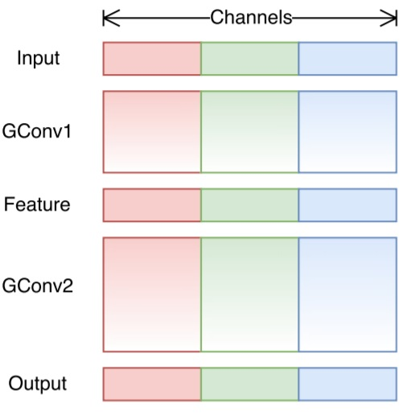
Pointwise Grouped Conv (1x1 GConv)
ShuffleNet argues that the 1x1 convolution are also computationally costly. Pointwise grouped convolution, as the name suggested, performs group operations for 1x1 convolution. The operation is identical as for grouped convolution, with only one modification — performing on 1x1 filters instead of NxN filters (N>1).
Grouped convolution is computationally efficient. The problem is that each filter group only handles information passed down from the fixed portion in the previous layers.
Shown in Figure X, we have 3 filter groups (RGB) each responsible for ⅓ of the input processing.
As such, each filter group is only limited to learn a few specific features. This property blocks information flow between channel groups and weakens representations during training.
To overcome this problem, we apply the channel shuffle.

Slide 22
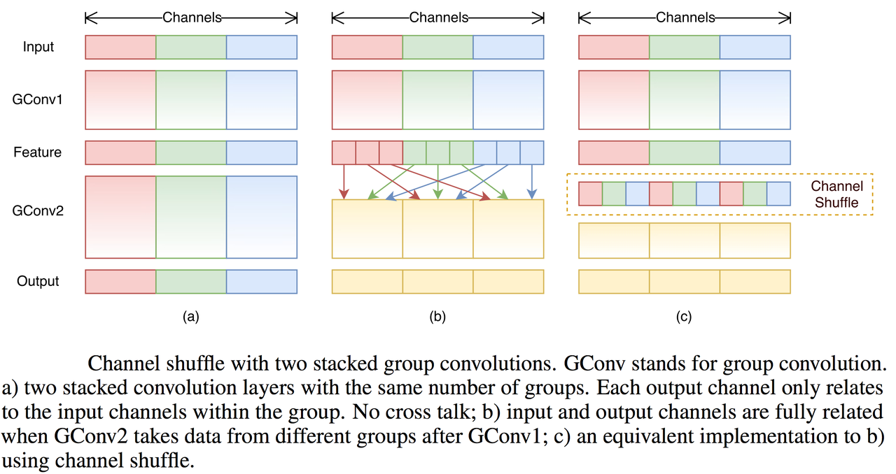
Channel Shuffle
Channel shuffle is utilized after the pointwise group convolution to ensure information flows across channels in different groups.
Basically, the main idea is that we want to mix up the feature information from different filter groups.
After GConv1 we obtain a feature map divided into 3 groups (RGB), instead of directly feeding this newly obtained feature map into the next layer (a) we first divide the channels in each group into several subgroups (b), then mix up these subgroups accordingly (c), as referenced in Figure X

Slide 23
Depthwise Conv (3x3 DW Conv)
In Depth wise conv, each filter channel is applied separately to its corresponding feature map channel without accumulating over depth.
Even though Pointwise conv helps project representations in deep feature maps to shallower feature maps, a 1x1 receptive field does not encode information from neighboring pixels in each channel of the feature map.
Hence, pointwise layers are followed by Depthwise conv layers with larger receptive fields, such as 3 x 3.

Slide 24
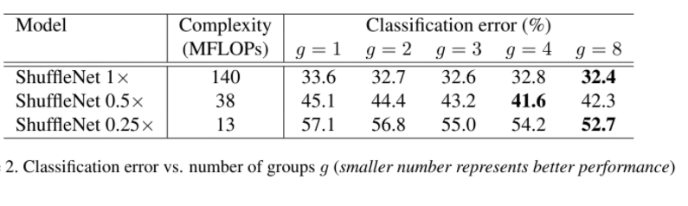
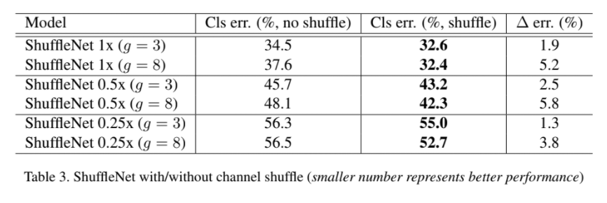
Results 2017 (Paper)

Slide 25
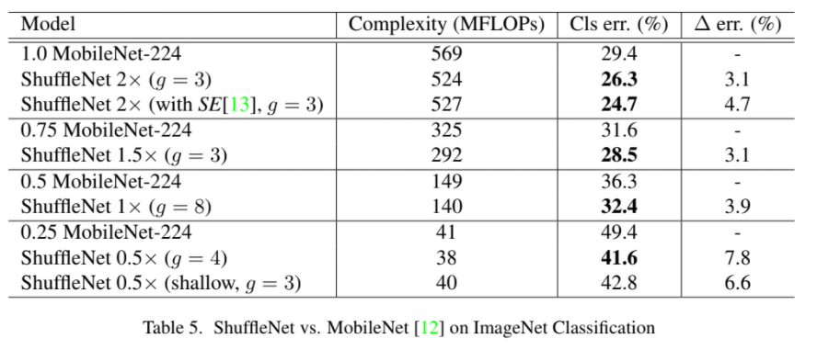
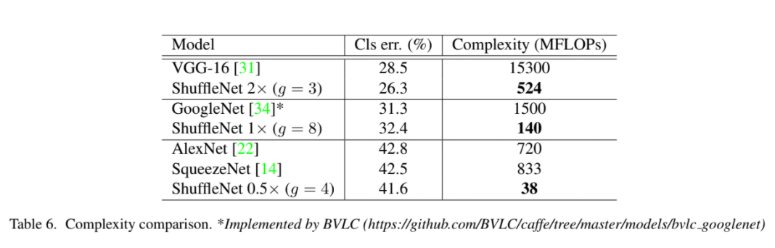
Results Cont.

Slide 26
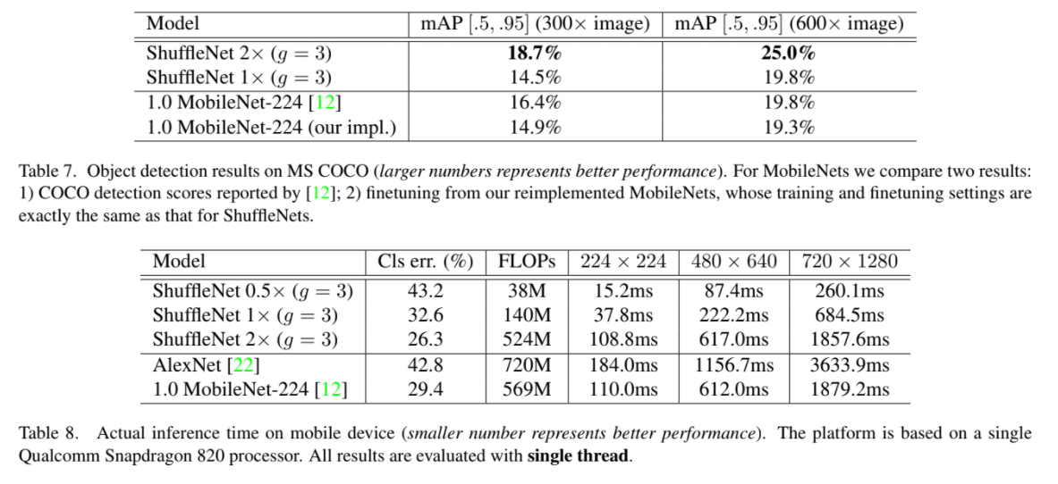
Results Cont.

Slide 27
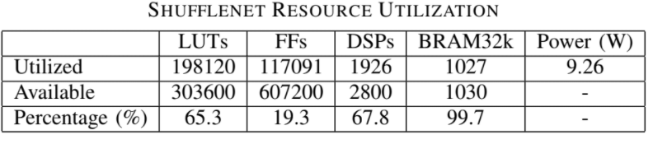
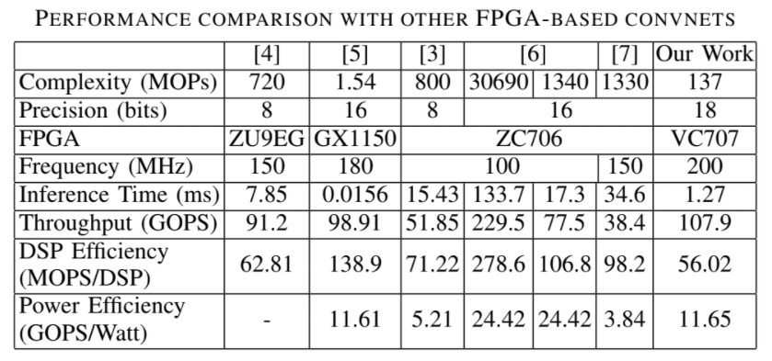
Results 2020 (FPGA)

Slide 28
ShuffleNet V2
The ShuffleNetV2 paper has an interesting discussion about how different types of layers perform on actual hardware. The authors use those insights to come up with an improved network structure.
When analyzing the speed of the model they realized it’s not really worth doing grouped convolutions after all. These do have the benefit of requiring fewer parameters and computation — but if you then use this to justify having more channels in order to boost the accuracy of the model, the number of memory accesses also goes up. And when it comes to speed, it’s those extra reads and writes that slow the model down.

Slide 29
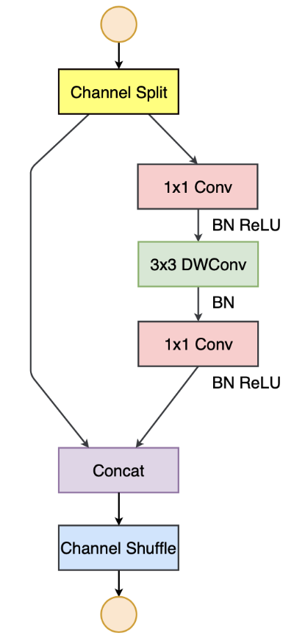
ShuffleNet V2 Cont
The new ShuffleNet v2 building block is shown in Figure X.
To replace the group convolutions, there is a new channel split operation, which sends half the channels through the left branch and the other half through the right branch — this is like using two groups.
The 1×1 convolutions are no longer groupwise.
The convolutions now always have the same number of input and output channels. They found that, when the number of channels stays the same, the amount of memory accesses in the convolution is optimal.
The shortcut connection is now always concatenated, not summed — this is the reverse operation of the channel split at the beginning. (So, technically speaking it’s no longer a residual connection.)
The channel shuffle is still there but has moved to the end.

Slide 30
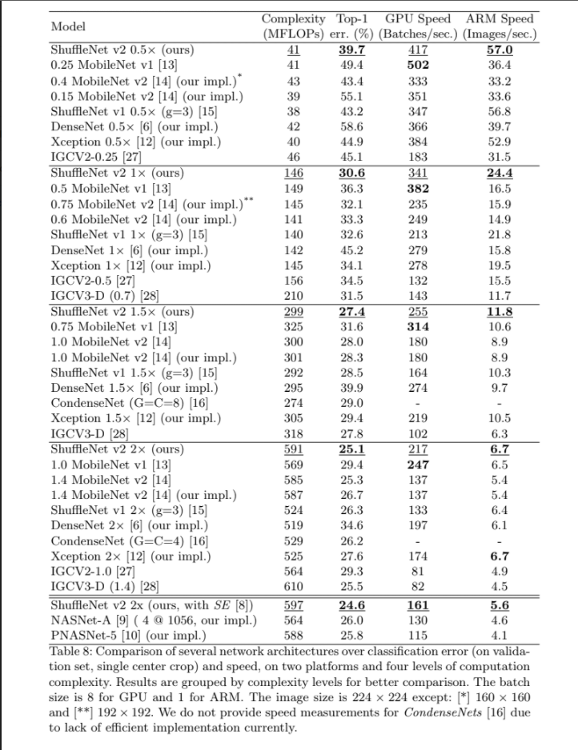
Results 2018 (Paper)

Slide 31
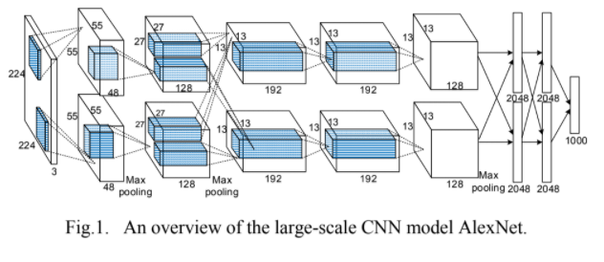
AlexNet
Convolutional neural networks have become present in computer vision ever since AlexNet popularized deep convolutional neural networks by winning the ImageNet Challenge: ILSVRC 2012.
The original AlexNet paper is considered fundamental in introducing CNN to the machine vision space. Some of the paper’s designs are considered outdated or too large to consider on an FPGA implementation, while other designs in the paper are still used to this day (data augmentation).
As shown in Fig X, the number of channels required in the FC layer is much more memory intensive compared to previous architectures discussed.

Slide 32
Architecture
AlexNet implementation follows a standard convolution pattern based on what was discussed in Week 2 presentation.
However when introducing FPGA design limitations certain actions can be taken in order to reduce convolution complexity (Conv layer) and parameter sizes (FC layer).
Conv layer:
Fast Fourier Transform Convolution can be efficiently performed in frequency domain.
Winograd minimal filtering is a fast algorithm based on Chinese Remainder Theorem, for performing convolution operation.
Others...
FC layer:
Batch-computing
Others...

Slide 33
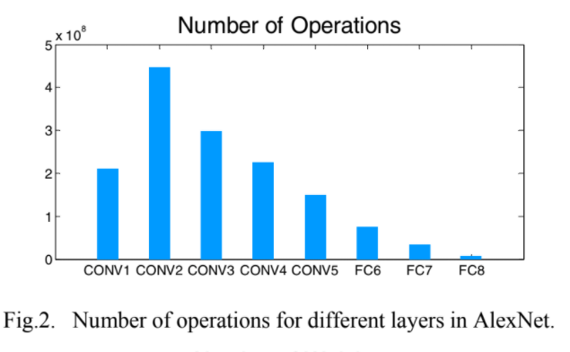
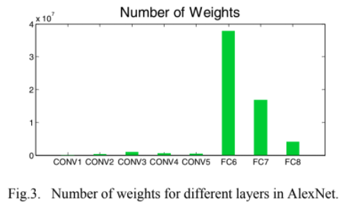
Batch-Computing
Batch-based computing method on FC layers can be used to reduce the required bandwidth, which is based on the batch processing. Meaning multiple input images can be processed in parallel as a batch with the same weights.
During computing, layers read weights from the off-chip memory simultaneously, where high memory bandwidth is still required. Fig. X has shown that FC layers contribute to most of the data accesses.

Slide 34
Going Forward
ShuffleNet proved capable of controlling the leverage of both accuracy and parameter density. However, it can be risky to attempt a shufflenet FPGA implementation due to the fact that the resources are limited.
MobileNet is a much simpler design and on top of that there is large flexibility in tweaking the network’s hyper params to leverage both accuracy and parameter density. Moreover, MobileNet has a much more prominent research space compared to ShuffleNet.
AlexNet is much more prominent in its FPGA implementations than both above networks discussed, however due to the fact that Depthwise Separable convolutions can satisfy the convolutional computations and are much more suited for lightweight implementations, we would like to explore an architecture where the convolutional layer carries a DWS conv and use AlexNets FC layer reductions in order to gain a foothold on both architectures.
More reading into FC reductions is needed as well as exploring prototype implementations of DWS convs on FPGAs. (MNIST)

Slide 35
Model | Alexnet |  | Mobilenet
Input size(Width multiplier) | 224x224 | 128x128 | 224x224(1) | 224x224(0.25) | 128x128(1) | 128x128(0.25)
#Parameters | 22,247,768 | 6,519,128 | 3,241,164 | 221,628 | 3,241,164 | 221,628
Parameters’ size | 85MB | 25MB | 13MB | 1MB | 13MB | 1MB
Largest #parameters in same layer | 22,151,424 | 6,422,784 | 1,048,576 | 65,536 | 1,048,576 | 65,536
Cloud infer time | 0.386 | 0.373 | 0.824 | 0.798 | 0.773 | 0.754
Cloud total time | 5.536 | 4.908 | 10.690 | 6.784 | 8.735 | 6.491
RPI infer time | 6.996 | 2.304 | 8.431 | 0.840 | 3.186 | 0.266
RPI total time | 7.204 | 2.496 | 8.642 | 1.051 | 3.381 | 0.462

Slide 36
Model | Mobilenet |  | Mobilenet [1] | Custom [2]
Top 1 Accuracy | 98% | 98% | 89% | 88.7%
Dataset Size | 22,680 | 22,680 | 6,970 | 3,663
#Classes | 12 | 12 | 6 | Binary
Input size(Width multiplier) | 224x224(0.25) | 128x128(0.25) | 224x224(0.5) | 64x64
#Parameters | 221,628 | 221,628 | 1.3 million | 45,281
Parameters’ size | 1MB | 1MB | 5.46 MB | 45K
Cloud infer time | 0.798 | 0.754 | Mobile 0.406 | GPU Tesla 0.28
Cloud total time | 6.784 | 6.491
RPI infer time | 0.840 | 0.266
RPI total time | 1.051 | 0.462

Slide 37
Apple | Corn | Tomato
Healthy | Healthy | Healthy
Scab | Cercospora leaf spot | Mosaic virus
Rust | Rust | Yellow leaf curl virus
Black rot | Blight | Early blight

